Slide 1

Quick Reference Parts Guide
Introduction
Main Menu
This Quick Reference Parts Guide is an easy way to locate part numbers to common replacement parts. It does not include items such as wire or their cord grips, terminal blocks, or mounting brackets. It also does not include standard hardware like nuts and bolts. To locate parts that are not covered here, refer to the drawing set in your equipment manual, part number 001075.
Navigating the
CD
Exit
www.mii.com
mitekparts@mii.com

Slide 2
Navigating the
Quick Reference Parts Guide
Main Menu
The next screen is the Main Menu, which has buttons to reach each category that this parts guide uses.
Each category may be further divided into different sections, each with their own button on the category’s main screen.
From each screen, you can:
  Return to the Main Menu
  Return to the category’s main page
  Go forward or backward one screen at a time within the category
  Click a link to order the part on-line or via e-mail
In addition to using the buttons provided, you can manually scroll through the screens by clicking your left mouse button.
Exit
How to get
To the
eStore
To access a different program or file while leaving the Quick Reference Parts Guide open, hold the Alt button while pressing the Tab button on your keyboard.
www.mii.com
mitekparts@mii.com

Slide 3
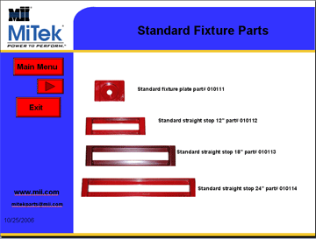

How to Get to the eStore™
Example
Once you find the part number you need, click on the Web site link.
www.mii.com
mitekparts@mii.com

Slide 4
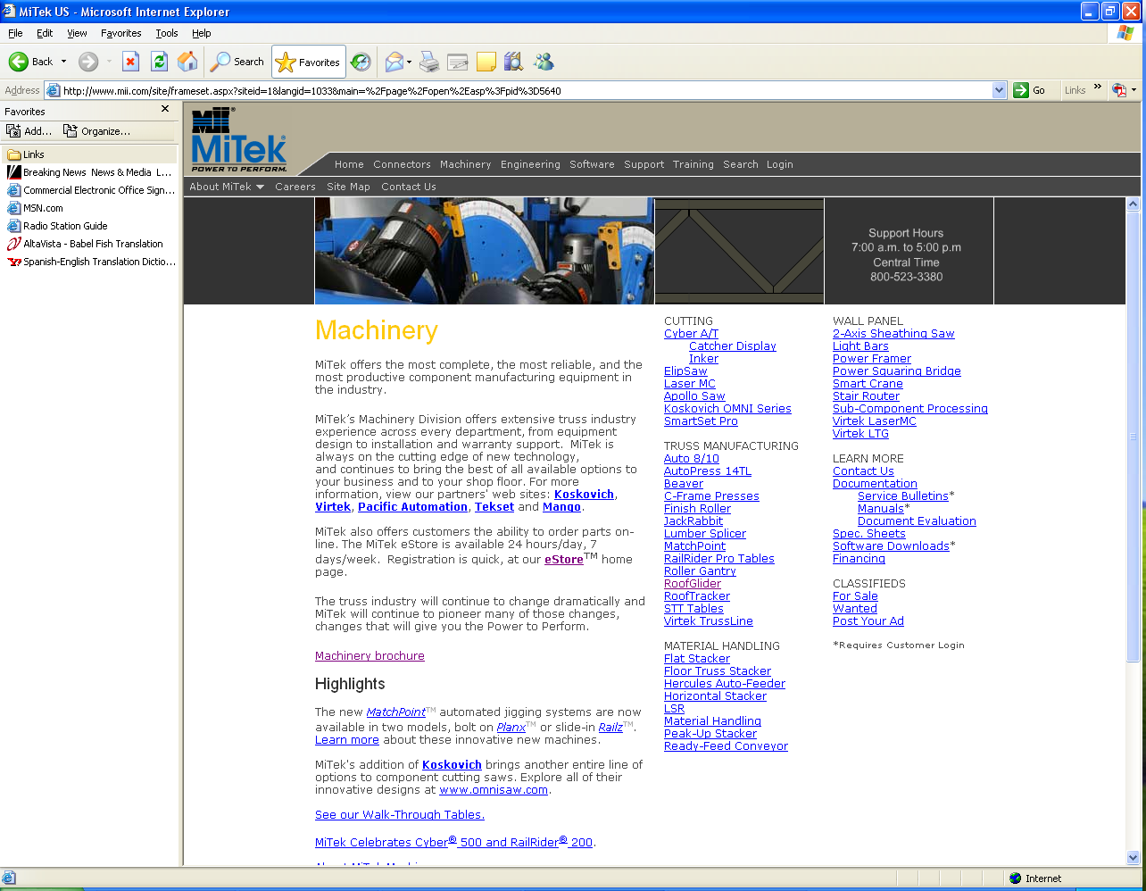
How to Get to the eStore
www.mii.com
This is the Web site. Click on the Machinery menu.
mitekparts@mii.com

Slide 5
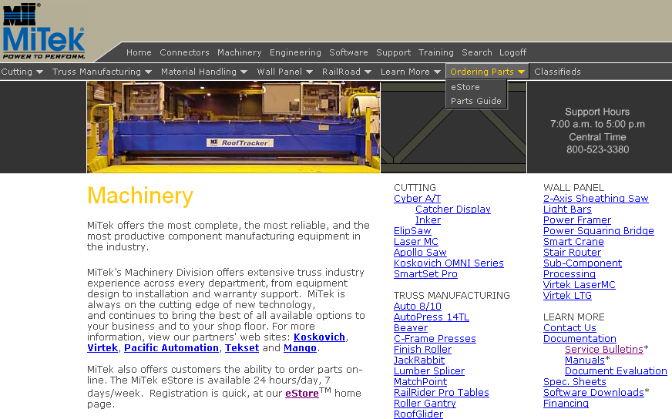
How to Get to the eStore
www.mii.com
mitekparts@mii.com
Click the Ordering Parts menu, then, click eStore.

Slide 6
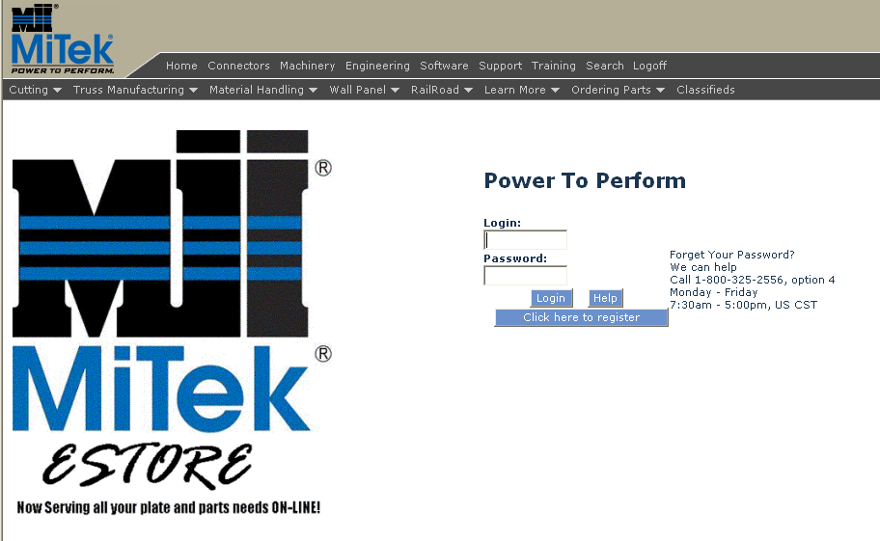
How to Get to the eStore
Main Menu
Exit
www.mii.com
Enter your eStore login and password and click Login.
If you need to register, click the Click here to register button.
mitekparts@mii.com

Slide 7
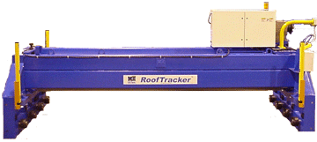
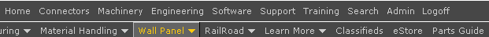
Main Menu
™
RoofTracker PARTS
Navigating the
CD
Electrical Parts
Mechanical Parts
Exit
Guards and Covers
Safety Labels
1
2
Click on the one of the links to the right to order your parts from our on-line eStore or via e-mail.
http://www.mii.com/machinery
www.mii.com
mitekparts@mii.com
mitekparts@mii.com

Slide 8
Electrical Parts Menu
Main Menu
Electrical Parts
Exit
Electrical Safety Devices
www.mii.com
mitekparts@mii.com

Slide 9
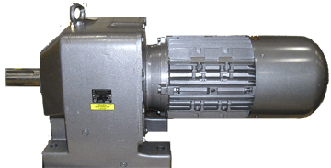
Electrical Parts
Main Menu
Sold as gear motor assembly only
Back To Electrical Parts
For incoming 208 volt gear motor part# 480410
For incoming 230 volt gear motor part# 480387
For incoming 460 volt gear motor part# 480387
Exit
www.mii.com
mitekparts@mii.com

Slide 10
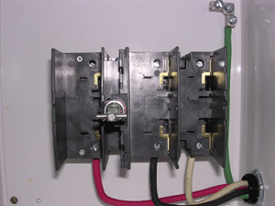
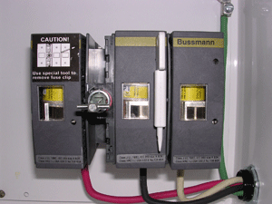
Electrical Parts
Main Menu
Disconnect switch fused 60 A
Part# 509429
Disconnect shaft
Part# 509424
Back To Electrical Parts
Incoming 208/230 volts fuse part# 516494
Exit
Incoming 460 volts fuse part# 516491
Incoming 575 volts fuse part# 516490
www.mii.com
mitekparts@mii.com

Slide 11
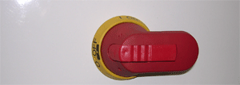
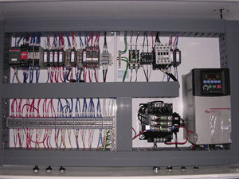
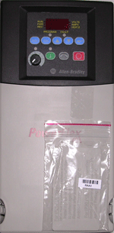
Electrical Parts
Main Menu
Disconnect handle part# 512297
Back To Electrical Parts
Exit
Frame # 1 to 23 VFD programmed for 208 volts part# 94015-208V
Frame # 24 and up VFD programmed for 208 volts part# 94016-208V
www.mii.com
Frame # 1 TO 23 VFD programmed for 230 volts part# 94015-230V
Frame # 24 and up VFD programmed for 230 volts part# 94016-230V
mitekparts@mii.com
Frame # 1 to 23 VFD programmed for 460 volts part# 94015-460V
Frame # 24 and up VFD programmed for 460 volts part# 94016-460V

Slide 12
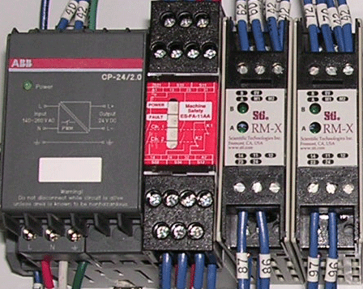
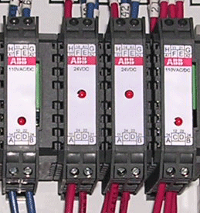
Electrical Parts
Main Menu
Back To Electrical Parts
Power supply
part# 509178
Safety relay
Part# 504531
Resource module
Part# 504533
Relay part# 514205
Exit
www.mii.com
mitekparts@mii.com
Relay part# 514186

Slide 13
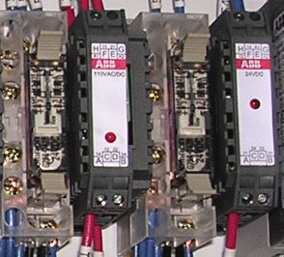
Electrical Parts
Main Menu
Relay part# 514186
Relay part# 514205
Back To Electrical Parts
Exit
Relay part# 504007
www.mii.com
mitekparts@mii.com

Slide 14
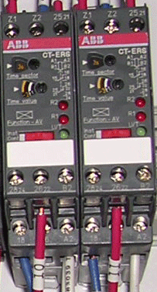
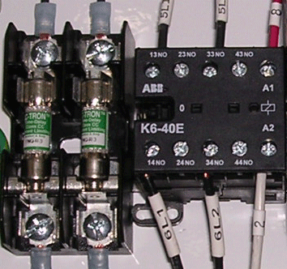
Electrical Parts
Main Menu
Timer part# 514196
Back To Electrical Parts
Contactor part# 512370
Exit
Fuse block part# 516333
www.mii.com
Incoming 208/230 volts fuse part# 516382
Incoming 460 volts fuse part# 516388
mitekparts@mii.com
Incoming 575 volts fuse part# 516383

Slide 15
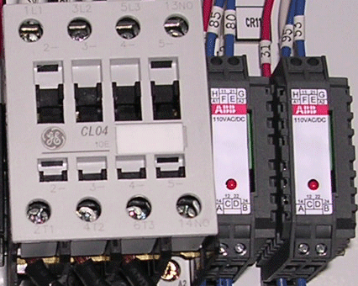
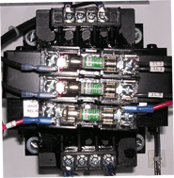
Electrical Parts
Main Menu
Relay part# 514186
Back To Electrical Parts
Motor starter part# 509219
Exit
Fuse holder primary part# 516402
Fuse holder secondary part# 516401
Incoming 208 volts primary fuse part# 516389
Incoming 230/460 volts primary fuse part# 516394
Incoming 575 volts primary fuse part# 516384
Incoming 208208/230/460 volts secondary fuse part# 516387
Incoming 575 volts secondary fuse part# 516350
www.mii.com
mitekparts@mii.com
Control transformer incoming 575 volts part# 509736
Control transformer incoming 208/230/460 volts part# 504595

Slide 16
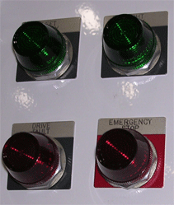
Electrical Parts
Main Menu
Pilot light part# 513596
Back To Electrical Parts
Name plate left ready part# 513946
Name plate right ready part# 513947
Name plate drive fault part# 513948
Name plate emergency stop part# 477005
Exit
Pilot light part# 513594
www.mii.com
mitekparts@mii.com

Slide 17
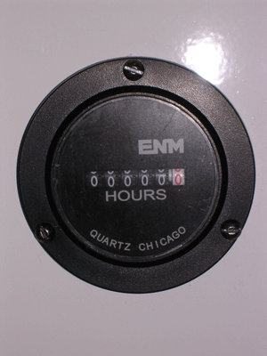
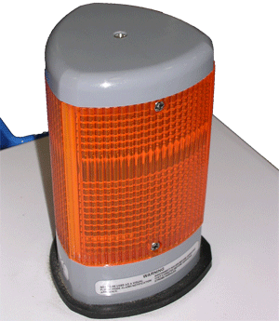
Electrical Parts
Main Menu
Hour meter part# 504700
Hour meter gasket part# 504701
Back To Electrical Parts
Exit
www.mii.com
Beacon lens modules amber part# 513522
mitekparts@mii.com
Beacon flashing LED part# 513523
Beacon base 102DMBS 120 VAC part# 513574

Slide 18
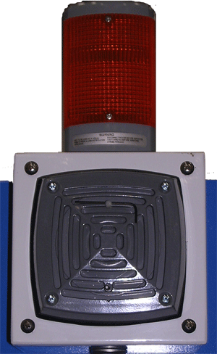
Electrical Parts
Main Menu
Beacon lens modules amber part# 513522
Back To Electrical Parts
Beacon flashing LED part# 513523
Beacon base 102DMBS 120 VAC part# 513574
Exit
Horn part# 513529
www.mii.com
mitekparts@mii.com

Slide 19
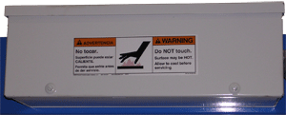
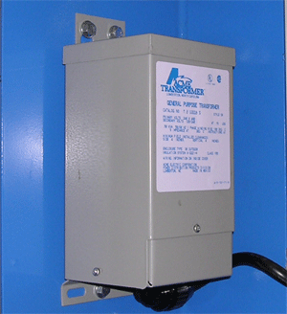
Electrical Parts
Main Menu
Braking resistor is inside this electrical box.
Back To Electrical Parts
Incoming 208/230 volts braking resistor part# 509801
Incoming 460 volts braking resistor part# 509802
Exit
Used on incoming 460/575 volts ONLY.
Transformer for incoming 460 volts part# 509117
Transformer for incoming 575 volts part# 509118
www.mii.com
mitekparts@mii.com

Slide 20
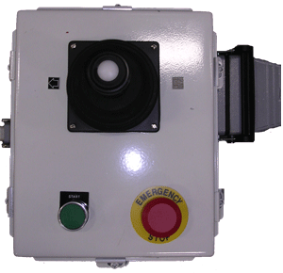
Electrical Parts
Main Menu
Receptacle inside the base part# 504582
Base part# 504579
Plug inside the hood part# 504581
Hood part# 504580
Back To Electrical Parts
Joystick part# 513856
Operator mushroom pushbutton, red part# 513171
Contact block on the back of the operator part# 513181
Name plate emergency stop part# 513191
Exit
Operator flush green part# 513170
Contact block on the back of the operator part# 513180
Name plate start part# 513190
www.mii.com
mitekparts@mii.com

Slide 21
Electrical Parts
Main Menu
Photo not available use detail numbers to get part number.
Back To Electrical Parts
Exit
www.mii.com
mitekparts@mii.com

Slide 22
Electrical Parts
Main Menu
Photo not available use detail numbers to get part number.
For 2 head system on the same table line.
Back To Electrical Parts
Exit
www.mii.com
mitekparts@mii.com

Slide 23

Electrical Safety Devices
Light curtain sold as a set part# 515824
This is the older style 3 beam
Light curtains you need to order what type you have
A 3 beam cannot be retrofitted to a new style 2 beam
at this time.
Main Menu
No photo Light curtain 2 beam set part# 515910
Back To Electrical Parts
Receiver cable part# 515841
8 wire cable
Exit
Transmitter cable part# 515840
3 wire cable
www.mii.com
mitekparts@mii.com
Transmitter
Receiver

Slide 24
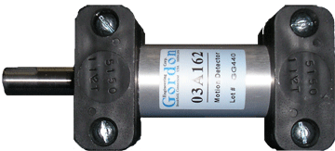
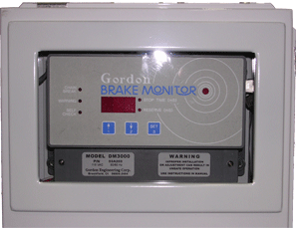
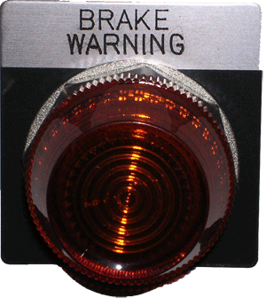
Electrical Safety Devices
Motion detector part# 509502
Main Menu
Back To Electrical Parts
Pilot light part# 513597
Name plate brake warning part# 513945
Brake monitor programmed part# 92163
Exit
www.mii.com
mitekparts@mii.com

Slide 25
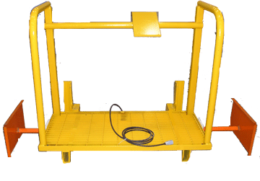
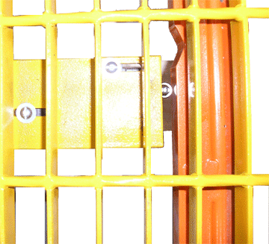
Electrical Safety Devices
Main Menu
Back To Electrical Parts
Exit
Safety switch under platform part# 515122
www.mii.com
mitekparts@mii.com

Slide 26
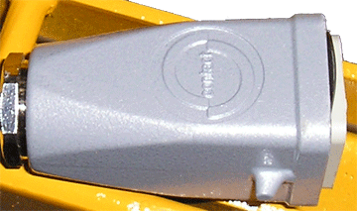
Electrical Safety Devices
Main Menu
Back To Electrical Parts
Hood part# 504576
Exit
Plug part# 504577
www.mii.com
mitekparts@mii.com

Slide 27
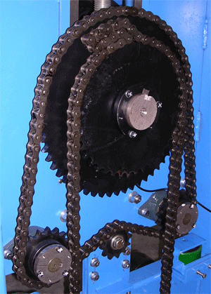
Mechanical Parts
Main Menu
Chain part# 554008 sold by the foot, need 9’
Connector link part# 554187
Off-set link part# 554188
Double single sprocket part# 552061
Exit
QD bushing part# 547097
Chain part# 554008 sold by the foot, need 8’
Connector link part# 554187
Offset link part# 554188
Bearing part# 419136
Sprocket part# 558131
www.mii.com
mitekparts@mii.com
Sprocket part# 549089
Qty. 4 per machine on later models
Qty. 8 per machine on earlier models
QD bushing part# 547220
Qty. 4 per machine on later models
Qty. 8 per machine on earlier models

Slide 28
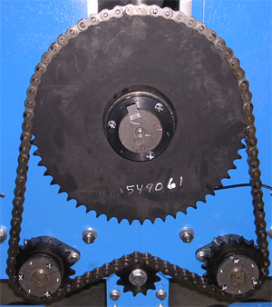
Mechanical Parts
Main Menu
Sprocket part# 549061
Exit
Chain part# 554008 sold by the foot, need 8’
Connector link part# 554187
Offset link part# 554188
Bearing part# 419136
Sprocket part# 558131
Sprocket part# 549089
Qty. 4 per machine on later models
Qty. 8 per machine on earlier models
QD bushing part# 547220
Qty. 4 per machine on later models
Qty. 8 per machine on earlier models
www.mii.com
mitekparts@mii.com

Slide 29


Mechanical Parts
Main Menu
Gear belt pulley part# 531070
Gear belt pulley modified for
the motion detector part# 63728
Exit
QD bushing part# 547125
Timing belt part# 530024
www.mii.com
Sprocket part# 549088
mitekparts@mii.com

Slide 30
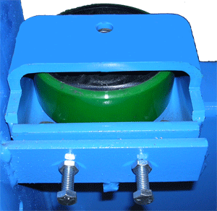
Mechanical Parts
Main Menu
Guide wheel pin part# 82830
Guide wheel weldment part# 63706-501
Exit
Guide wheel part# 580200
www.mii.com
mitekparts@mii.com

Slide 31
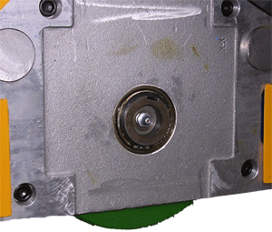
Mechanical Parts
Main Menu
Wheel block complete assembly
part# 63735-501
Exit
Wheel assembly part# 63733-501
Wheel housing w/spring this side part# 63775-501
Wheel housing opposite side part# 63734
Contents of the internal wheel block assembly:
Shaft bearing assembly part# 63705-501
Roller bearing part# 415511 Qty. 2
Seperable inner ring part# 415512
Snap ring part# 379016
Grease fitting part# 701003
Tie pin part# 63695
www.mii.com
mitekparts@mii.com
Unless the quantity ( Qty. ) is specified, the quantity is 1.

Slide 32
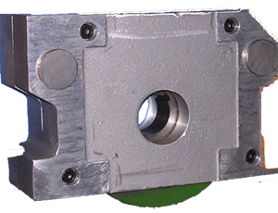
Mechanical Parts
Main Menu
Drive wheel block complete assembly, wheel only part# 65571-501
Exit
Drive wheel housing w/spring part# 63775
Drive wheel assembly part# 63733-501
Drive wheel housing part# 63734
www.mii.com
mitekparts@mii.com

Slide 33
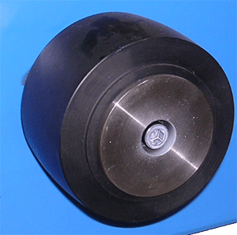
Mechanical Parts
Main Menu
Drive wheel part# 580194
Exit
Lock hub part# 82933
www.mii.com
mitekparts@mii.com

Slide 34
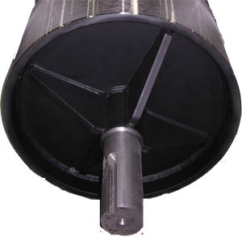
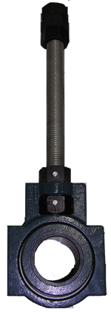
Mechanical Parts
Main Menu
Roller part# 63670-501
Exit
www.mii.com
Take – up bearing assembly part# 63721-501
mitekparts@mii.com

Slide 35
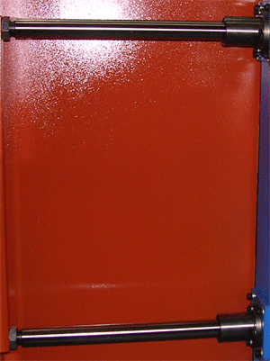
Mechanical Parts
Frame #177 and above order the part# in blue or if you have upgraded to a
SB173KIT-A or SB173KIT-B order the # in blue. It is recommended if you have not upgraded to do so.
Main Menu
Linear bearing part# 416076
416003
Bumper shaft part# 63711
Exit
63841
Jam nut part# 361666
Linear bearing part# 416076
www.mii.com
416003
mitekparts@mii.com
Bumper shaft part# 63711
63841

Slide 36
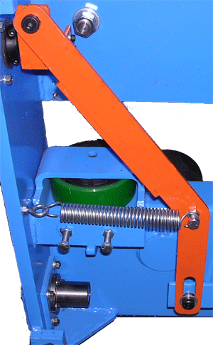



Mechanical Parts
Frame #177 and above order the part# in blue or if you have upgraded to a
SB173KIT-A or SB173KIT-B order the # in blue. It is recommended if you have not upgraded to do so.
Shoulder bolt part# 328077
Bumper pivot arm part# 63715-501
Main Menu
Bronze bushing part# 405549
Poly pad part# 63842
Rubber washer part# 379801
Exit
Bumper mount part#63852-501
Return stop mount part#63849
Shaft collar part# 541274
541002
Slide arm bracket part# 63714
Extension spring part# 371815
www.mii.com
mitekparts@mii.com
Bronze bushing part# 405549
Shoulder bolt part# 328079

Slide 37
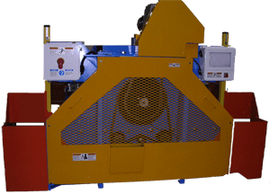
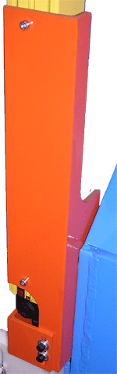
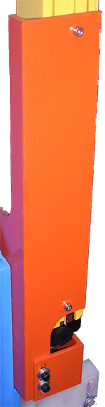
Mechanical Parts
Main Menu
Light beam mount part# 63718-002
Light beam mount part# 63718-001
Exit
www.mii.com
Light beam stop part# 63749
mitekparts@mii.com

Slide 38
Guards and Covers
Frame #177 and above order the part# in blue or if you have upgraded to a
SB173KIT-A or SB173KIT-B order the # in blue. It is recommended if you have not upgraded to do so.
Main Menu
Motor guard part# 63725
Chain tension cover part# 63769
Exit
www.mii.com
mitekparts@mii.com
End guard, drive end part# 63699-501
Bumper weldment part# 63710-501
Bumper weldment LH part# 63710-502
63851
63844

Slide 39
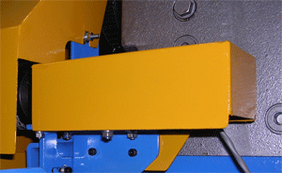
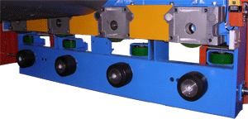
Guards and Covers
Main Menu
Brake monitor cover part# 63757-501
Exit
www.mii.com
mitekparts@mii.com
Wheel block guard part# 63672

Slide 40
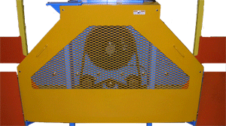
Guards and Covers
Frame #177 and above order the part# in blue or if you have upgraded to a
SB173KIT-A or SB173KIT-B order the # in blue. It is recommended if you have not upgraded to do so.
Main Menu
End guard part# 63771-501
Exit
www.mii.com
mitekparts@mii.com
Bumper weldment part# 63710-501
Bumper weldment LH part# 63710-502
63851
63844

Slide 41
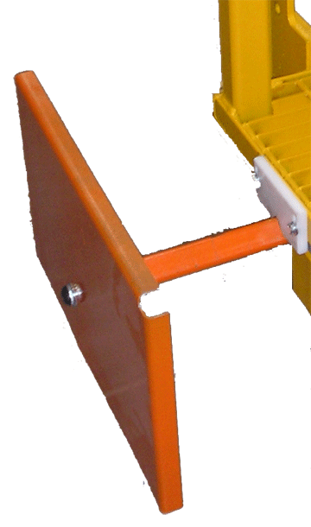
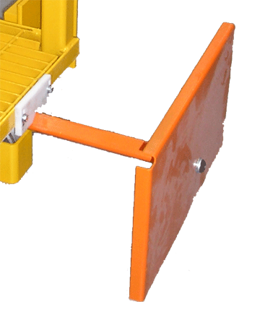
Guards and Covers
Riding platform complete part# 63800-501
Main Menu
Exit
Platform bumper LH part# 63811-501
Platform bumper RH part# 63810-501
Locking strip part# 63827
www.mii.com
mitekparts@mii.com
Bumper TB weldment part# 63812-501

Slide 42

Guards and Covers
Main Menu
Exit
Carriage wheel assembly part# 64515
www.mii.com
mitekparts@mii.com

Slide 43

Guards and Covers
Main Menu
Top guards part# 63709
Exit
www.mii.com
mitekparts@mii.com

Slide 44



Safety Labels
Main Menu
Part# 691518
Part# 691522
Exit
Part# 691523
www.mii.com
mitekparts@mii.com

Slide 45


Safety Labels
Main Menu
Part# 691507
Exit
Part# 691509
www.mii.com
mitekparts@mii.com

Slide 46


Safety Labels
Main Menu
Part# 691528
Exit
Part# 691701
www.mii.com
mitekparts@mii.com

